Slide 1
Data Analysis and Visualization on Global Youtube Statistics
Using Python libraries as NumPy, Pandas, Matplotlib, Seaborn

Slide 2
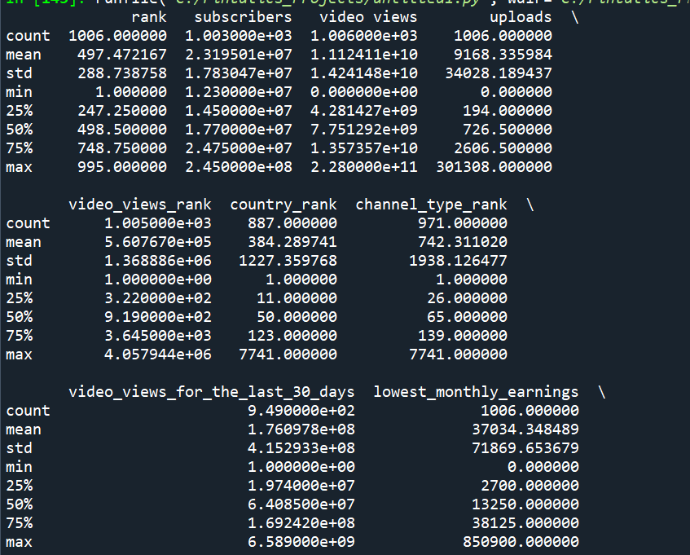
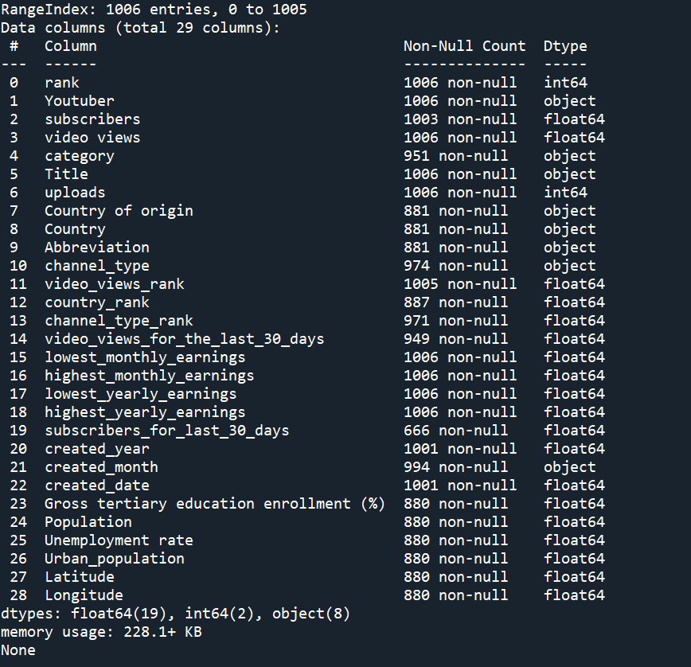
Identifying Structure of Data
Identifying different columns, datatypes, size, mean, standard Deviation, minimum, maximum and quaratiles of the raw data before we can proceed to data cleaning.

Slide 3
Data cleaning
Cleaning the raw data before processing by dropping redundant tuples and columns having the same meaning such as COUNTRY, ABBREVIATION and Youtuber
Identifying missing values in rows
Dropping rows for columns which have fewer missing values.
For larger number of missing values, filling them by imputation with appropriate central tendencies by identifying any outliers across attributes

Slide 4
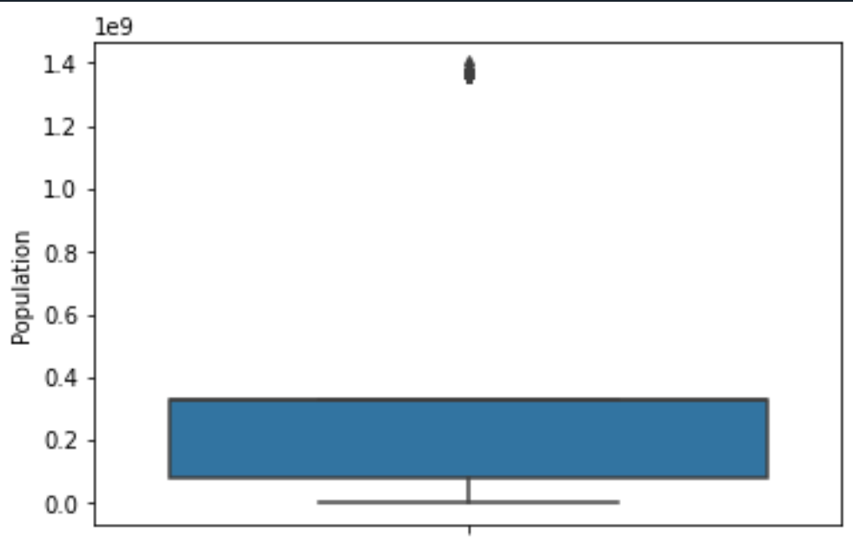
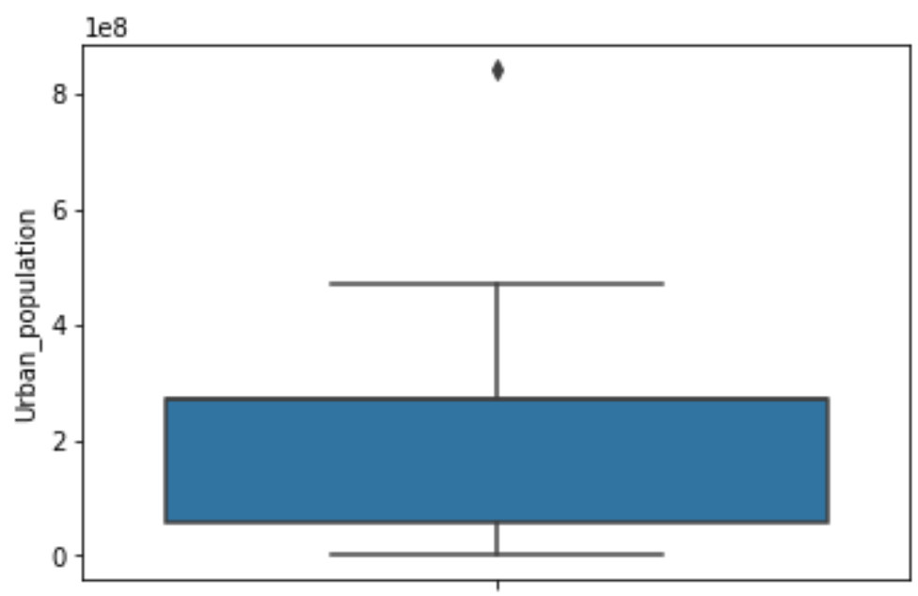
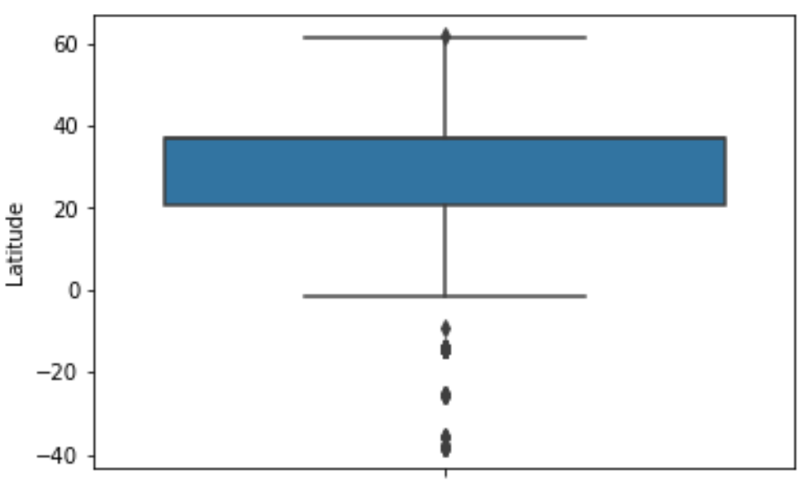
Some Outliers in the dataset

Slide 5
Statistical Analysis :
After data cleaning, statistics indicate that:
Top 10 youtube channels based on the subscribers were ['T-Series', 'MrBeast', 'Cocomelon - Nursery Rhymes', 'SET India', 'Music', 'ýýý Kids Diana Show', 'PewDiePie', 'Like Nastya Vlog', 'Vlad and Niki', 'Zee Music Company’]
The category with Highest Average number of subscribers was SHOWS.

Slide 6
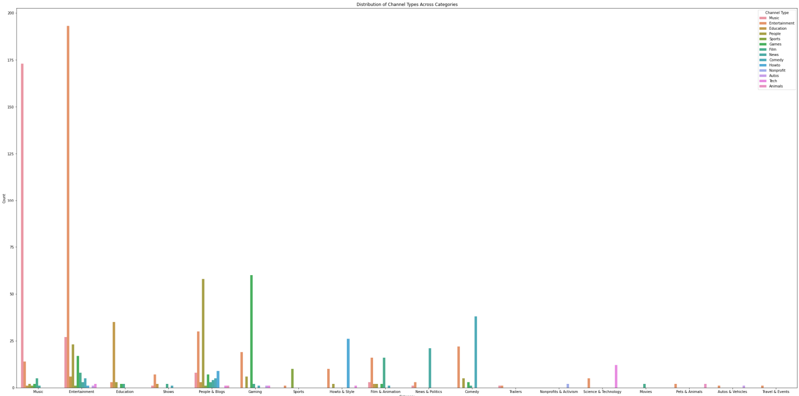
Maximum and minimum average number of videos uploaded were 301308 and 0 respectively with an average of 9327.77
Countries with Highest number of Youtube Channels were United States India Brazil United Kingdom Mexico 428 166 60 43 33
Distribution of Channels across Categories.

Slide 7
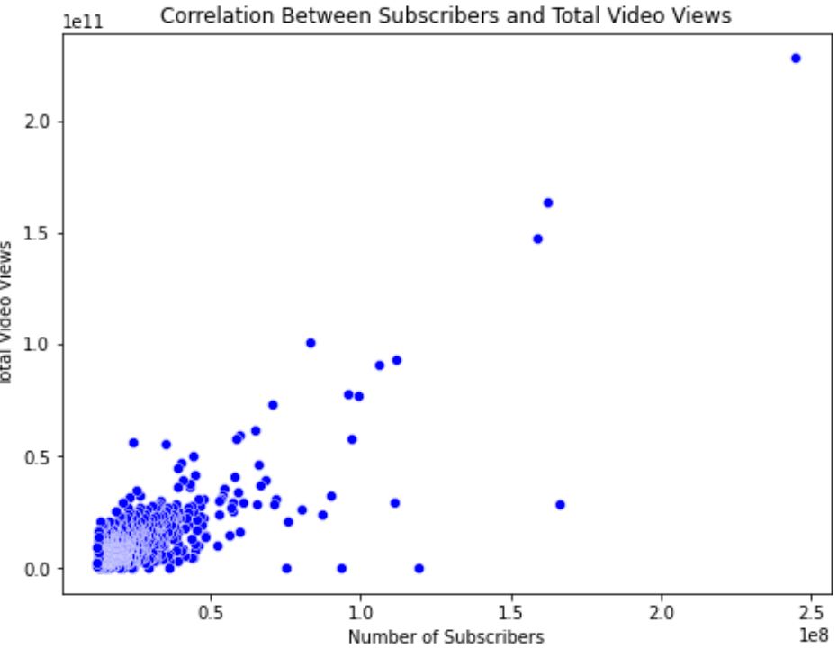
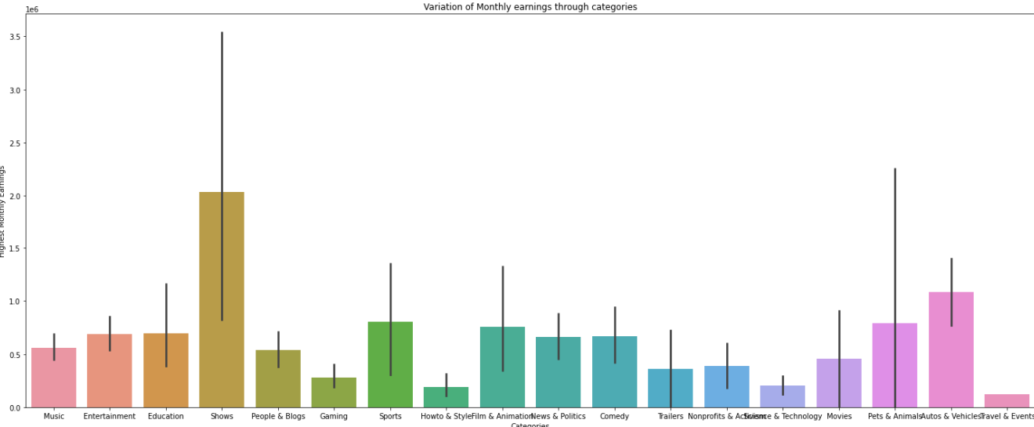

6) Correlation between Number of subscribers and Total video views shows a High positive correlation of 0.7861
7)Variation of Monthly incomes through categories show that SHOWS have high monthly income.

Slide 8
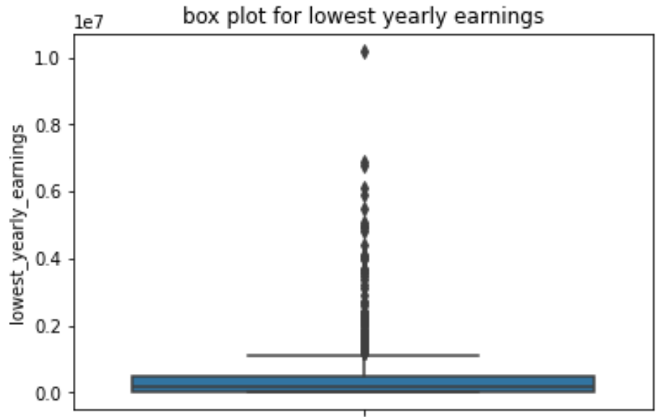
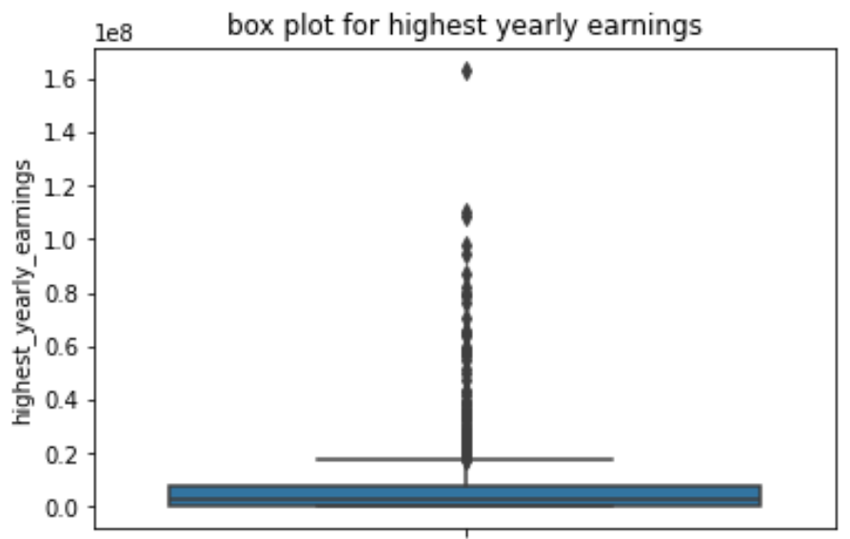
8) overall trend in subscribers gained in the last 30 days across all channels
9) Outliers in yearly earnings from Youtube channels

Slide 9
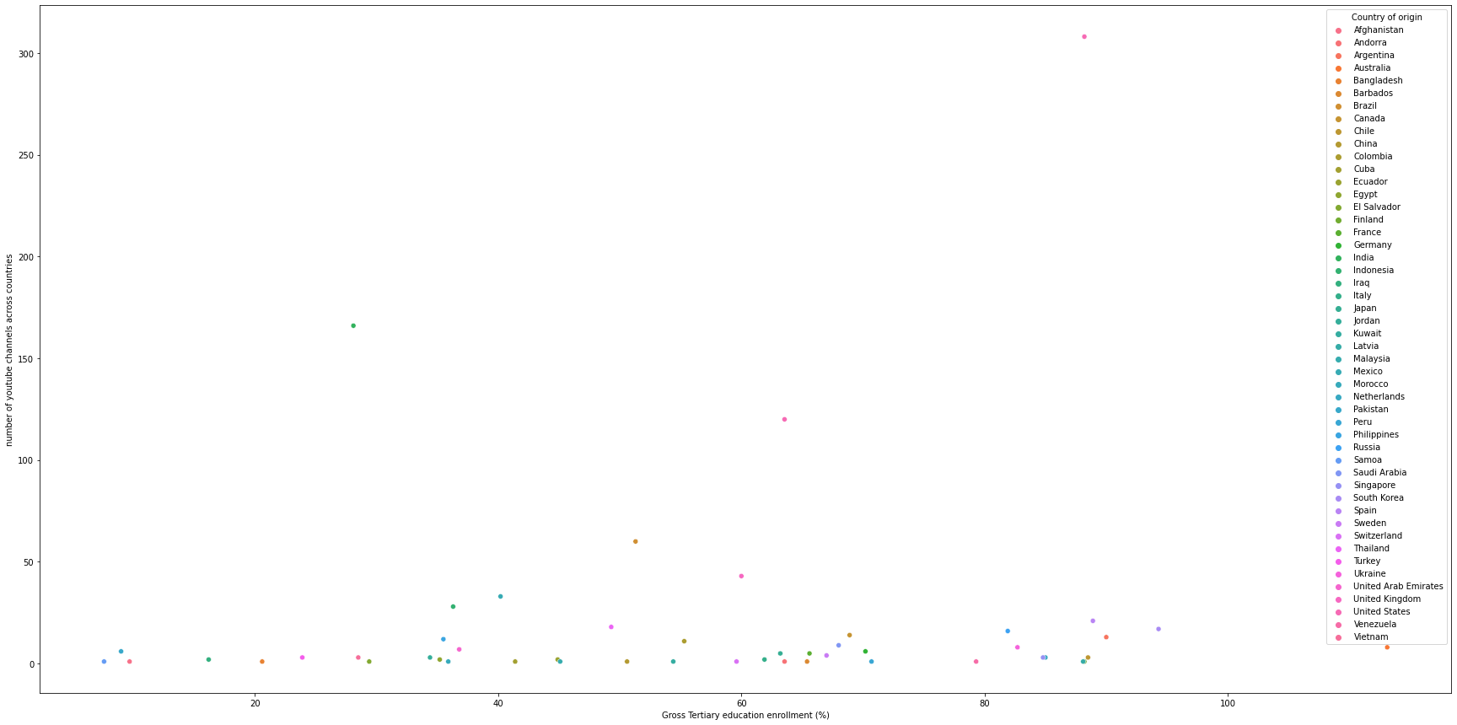
10) Distribution of Channel creation dates
11) Relationship between gross tertiary education enrollment and the number of YouTube channels in a country

Slide 10
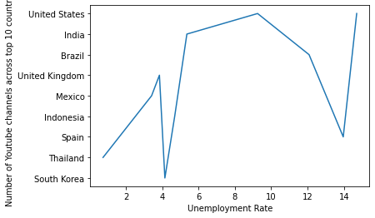
12) Variation of unemployment rate among the top 10 countries with the highest number of YouTube channels.
13)average urban population percentage in countries with YouTube channels is
Afghanistan 9797273.0
Andorra 270663028.0
Argentina 41339571.0
Australia 21844756.0
Bangladesh 60987417.0
Barbados 89431.0
Brazil 183241641.0
Canada 30628482.0
Chile 16610135.0
China 842933962.0
Colombia 40827302.0
Cuba 8739135.0
Ecuador 11116711.0
Egypt 42895824.0
El Salvador 4694702.0
Finland 4716888.0
France 54123364.0
Germany 64324835.0
India 471031528.0
Indonesia 151509724.0
Iraq 27783368.0
Italy 42651966.0
Japan 115782416.0
Jordan 9213048.0
Kuwait 4207083.0
Latvia 1304943.0
Malaysia 24475766.0
Mexico 102626859.0
Morocco 22975026.0
Netherlands 15924729.0
Pakistan 79927762.0
Peru 25390339.0
Philippines 50975903.0
Russia 107683889.0
Samoa 35588.0
Saudi Arabia 28807838.0
Singapore 5703569.0
South Korea 42106719.0
Spain 37927409.0
Sweden 9021165.0
Switzerland 6332428.0
Thailand 35294600.0
Turkey 63097818.0
Ukraine 30835699.0
United Arab Emirates 8479744.0
United Kingdom 55908316.0
United States 270663028.0
Venezuela 25162368.0
Vietnam 35332140.0

Slide 11
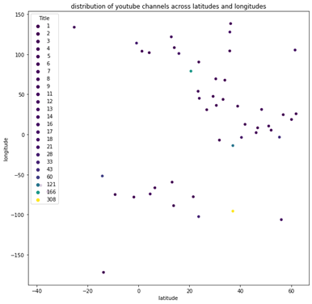
14) Distribution of YouTube channels based on latitude and longitude coordinates.

Slide 12
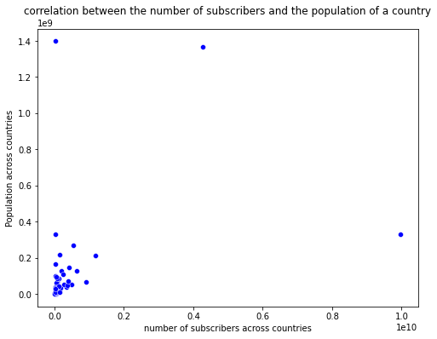
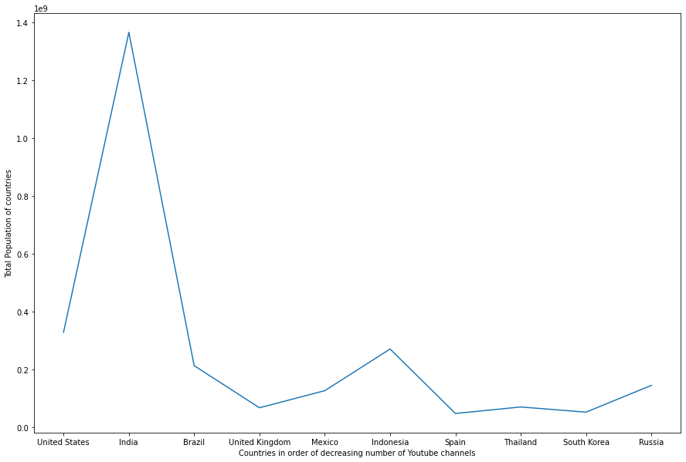
15) Correlation between the number of subscribers and the population of a country.
16) Top 10 countries with the highest number of YouTube channels compare in terms of their total population

Slide 13
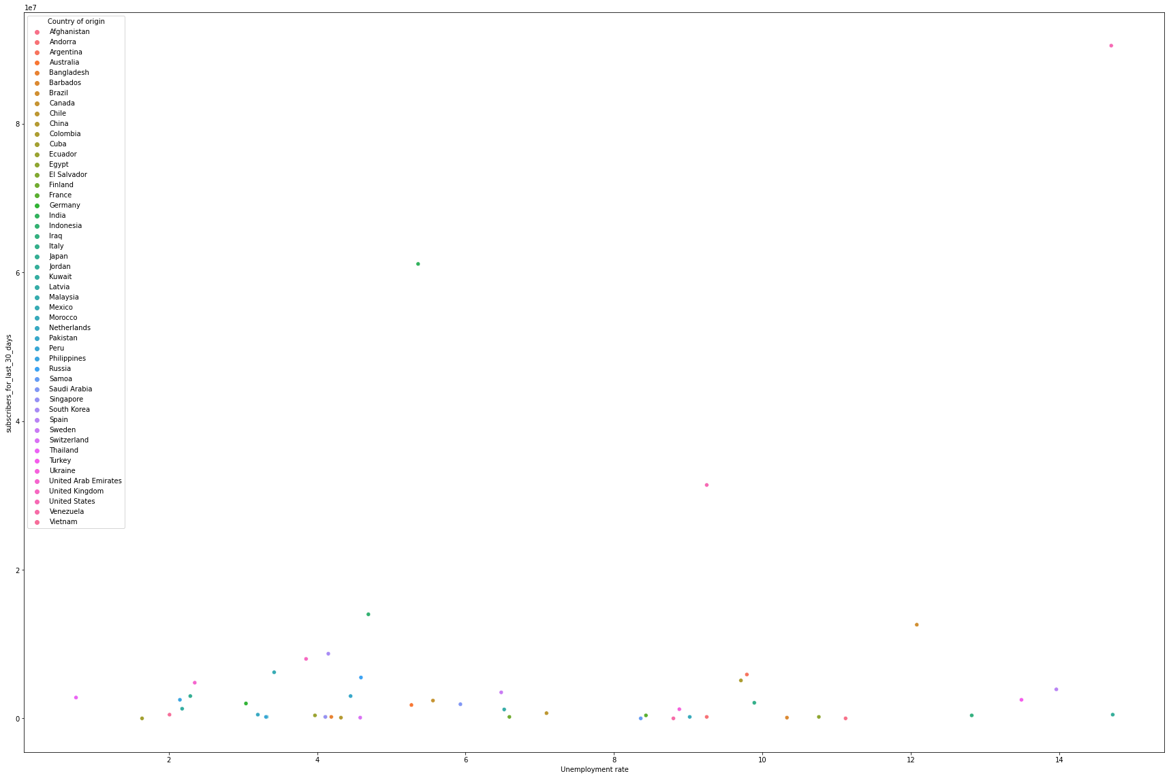
17) correlation between the number of subscribers gained in the last 30 days and the unemployment rate in a country

Slide 14
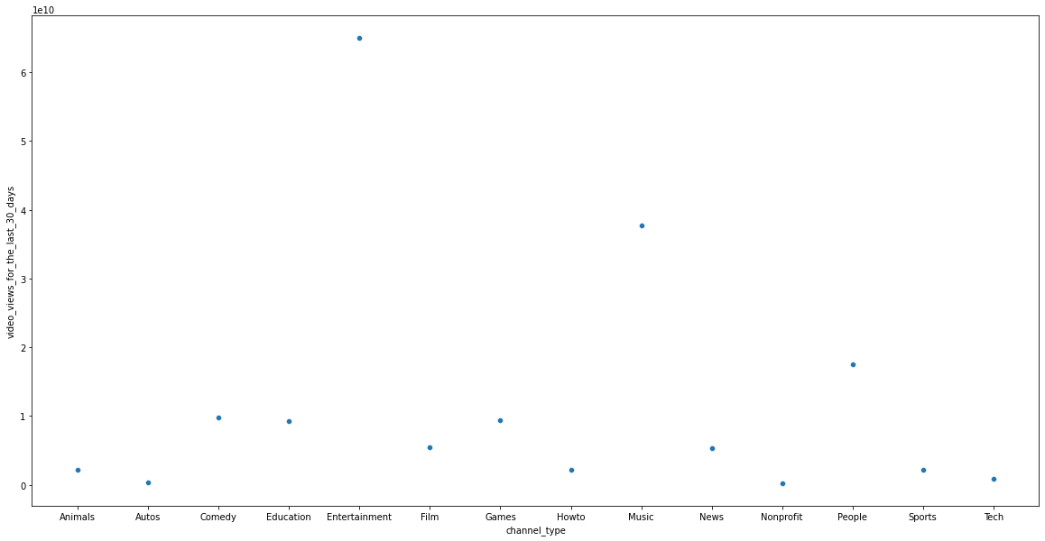
18) distribution of video views for the last 30 days across different channel types

Slide 15
19) seasonal trends in the number of videos uploaded by YouTube channels
20 )Average Number of subscribers gained per month since the creation of a youtube channel cant be calculated as each tuple indicate a youtube channel and we only have attribute of start date but no end date.

Slide 16
THANK
YOU

